Slide 1

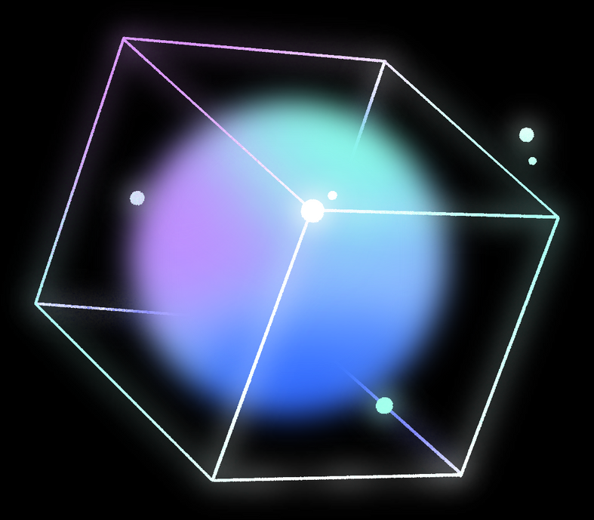
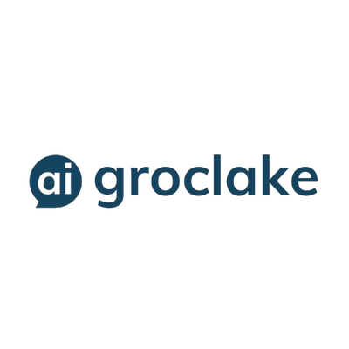

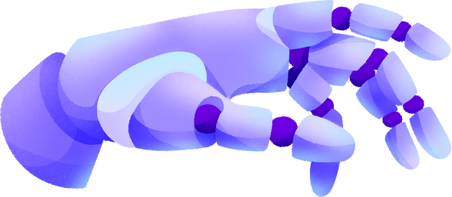

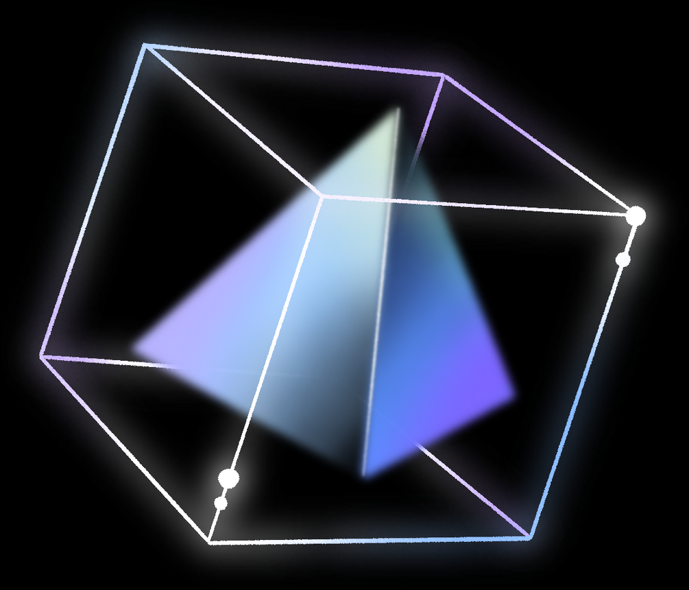
ARTIFICIAL INTELLIGENCE
GROCLAKE AGENTATHON
(NEXT GENERATION
AGENTIC APPS)
By Team Beyond Horizon

Slide 2

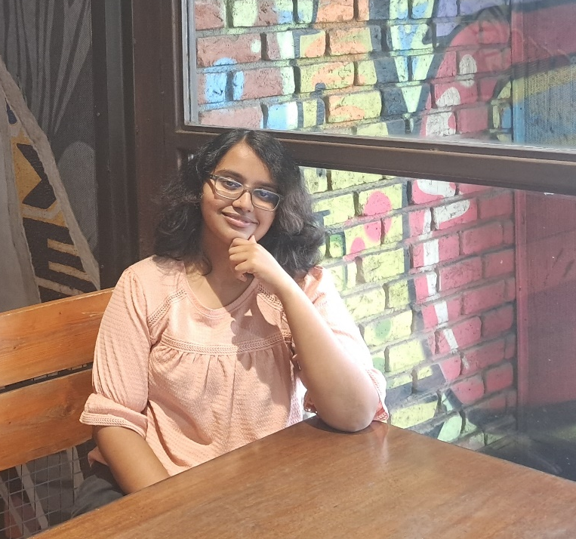
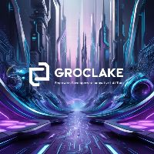
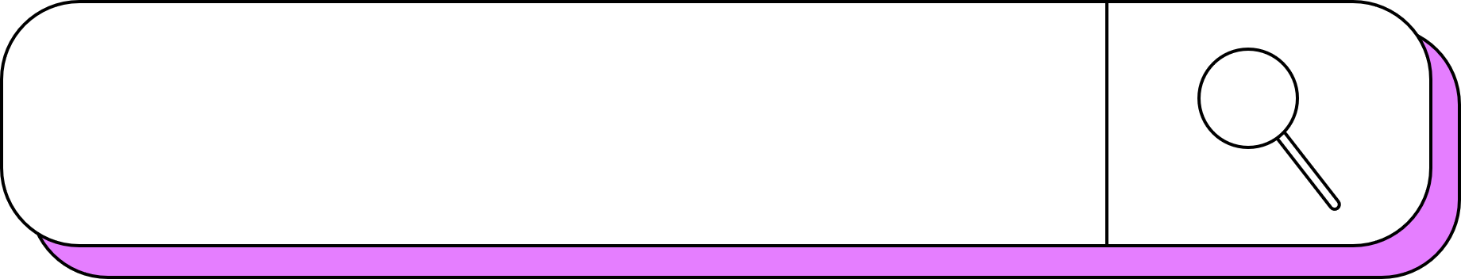
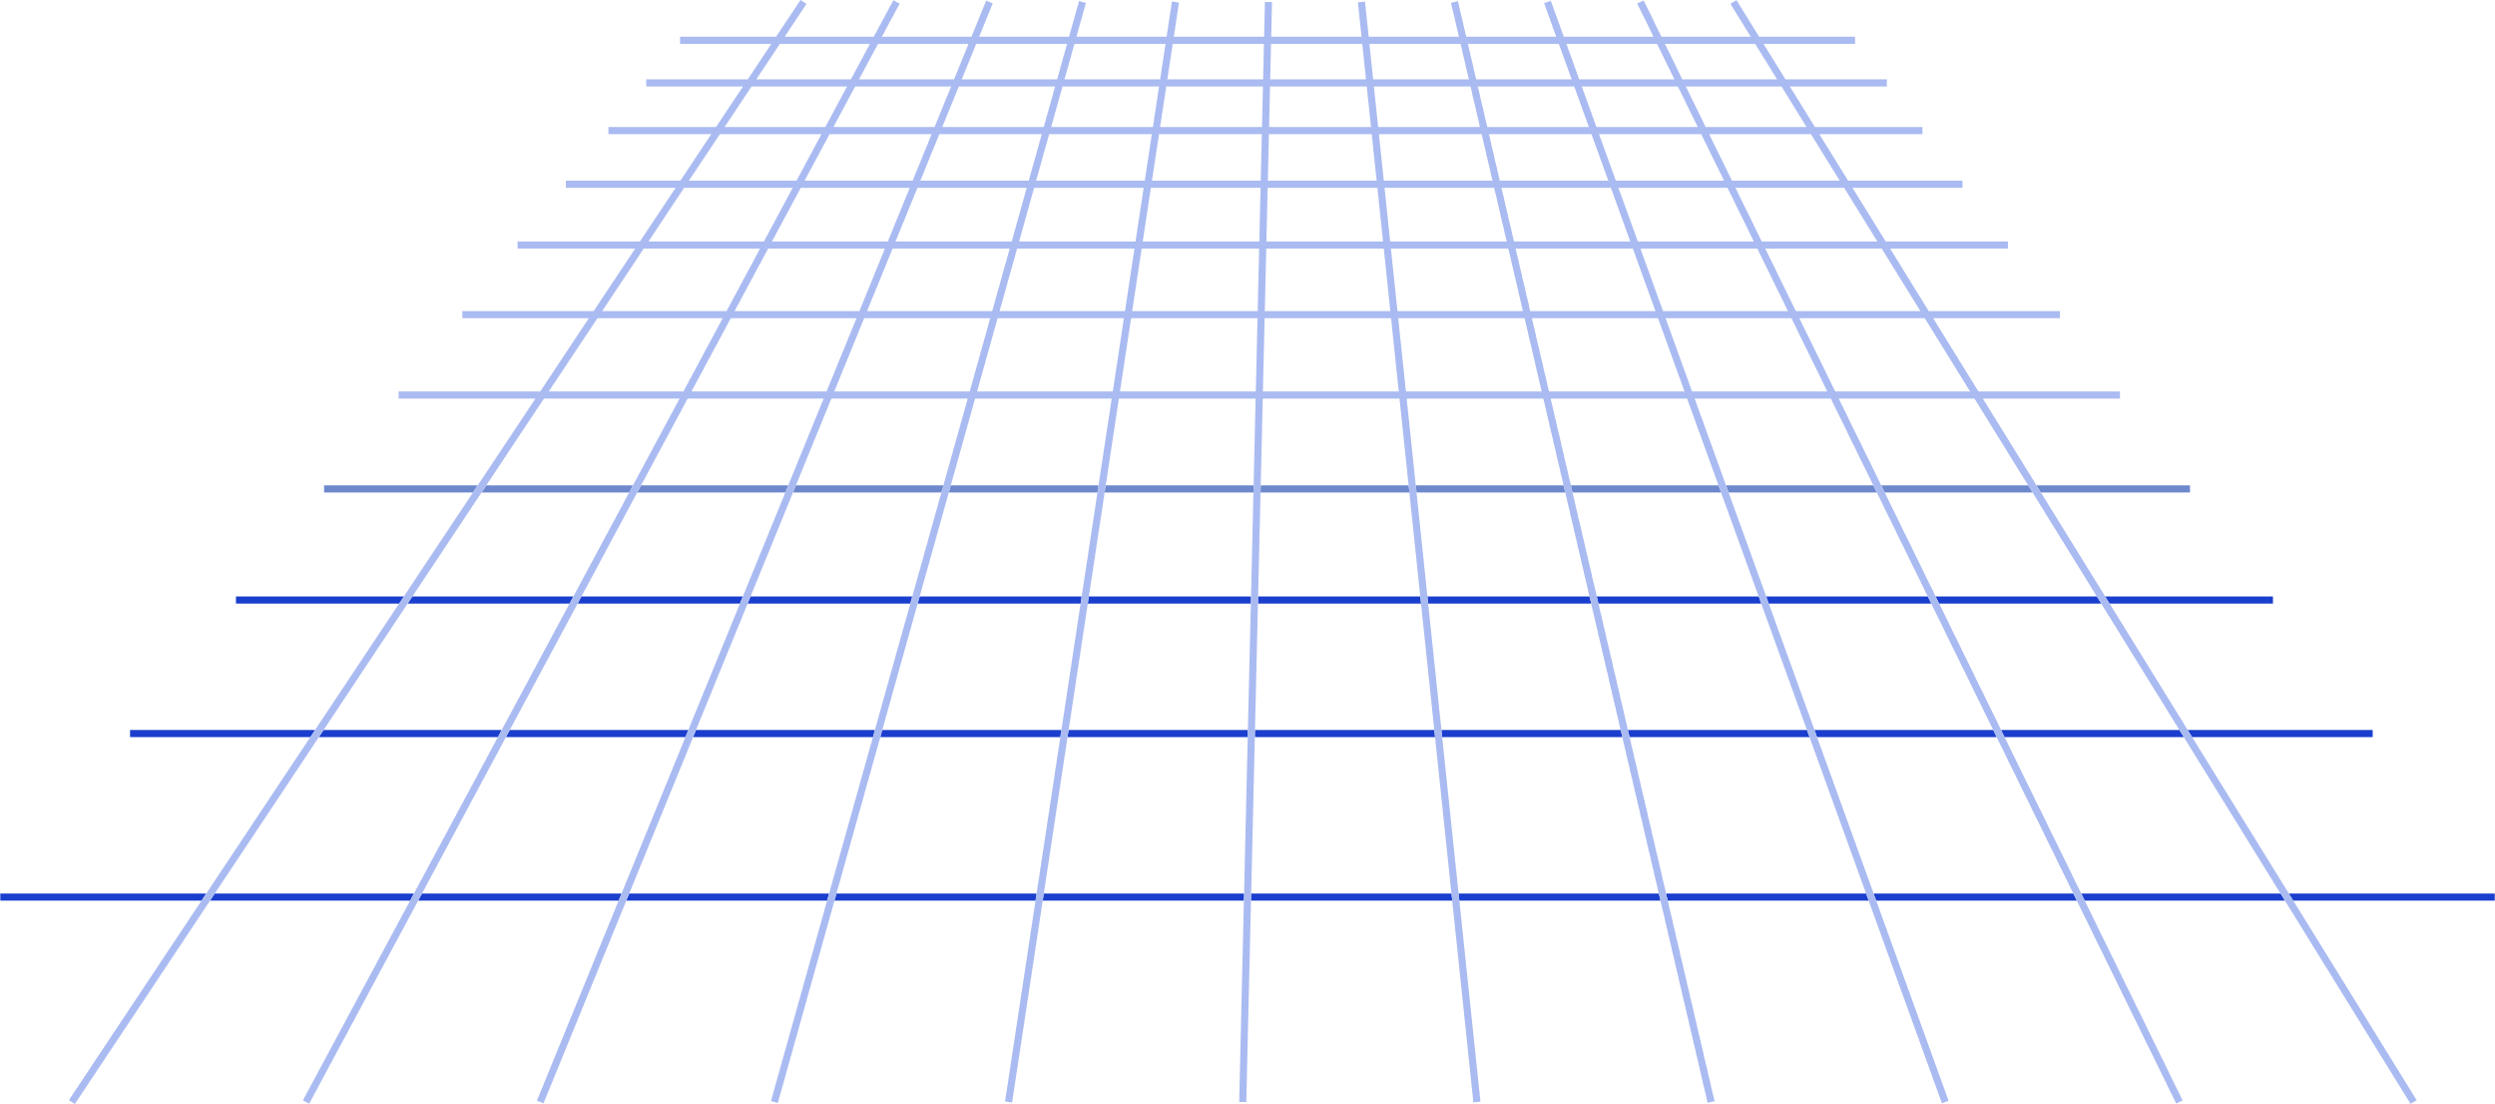
Meet the team
Sakshi Kumar
Groclake
Beyond Horizon

Slide 3
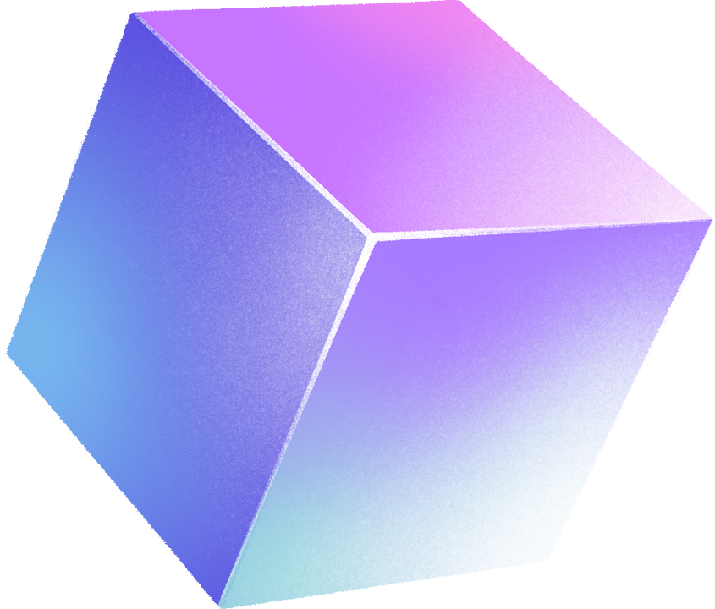
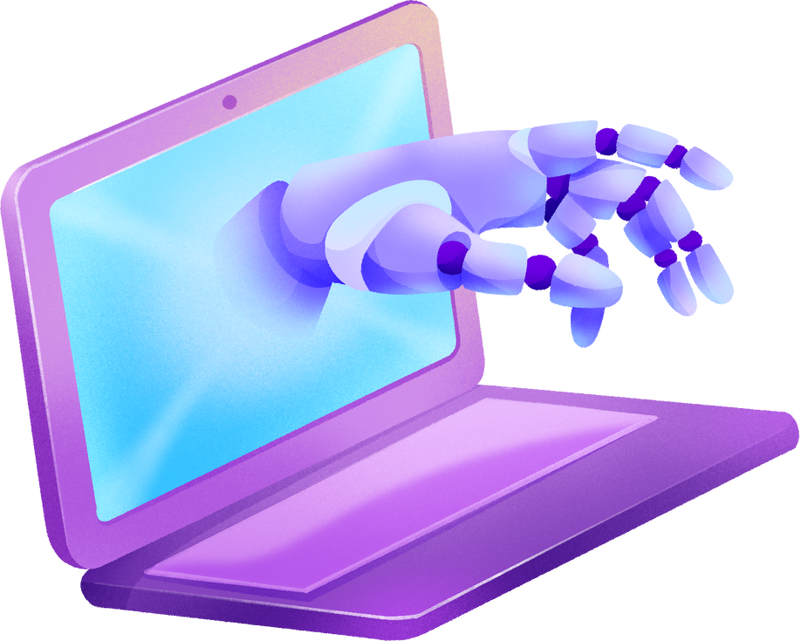
THEME
Revolutionizing Sustainable Agriculture
Harnessing the power of RAG-powered agentic apps and GrocLake tools to address modern farming challenges, delivering real-time insights, automation, and precision for smarter, more sustainable agricultural practices.
Reason for Choosing This Theme
REASON
I selected this theme because agriculture faces critical challenges like climate unpredictability, fragmented data, and inefficient workflows. Addressing these through advanced AI technologies can empower farmers with real-time insights and predictive solutions to boost productivity and resilience.
MOTIVATION
What excites me is the chance to make a tangible difference for farmers, especially in rural areas. Providing multilingual support, smart tools, and seamless integrations can democratize technology access. The potential for precision farming and automation to enhance sustainability and efficiency inspires me deeply.
WHY AGENTIC RAG?
Agentic RAG combines retrieval-augmented generation with autonomous decision-making. This enables real-time access to diverse data—like soil reports and market prices—and delivers context-aware recommendations. Its ability to automate workflows and adapt to changing conditions makes it ideal for helping farmers make faster, smarter decisions.

Slide 4







OBJECTIVES
PROBLEM
SOLUTION
CONTEXT
Farmers face challenges like climate unpredictability, fragmented data sources for soil health and weather, inefficient workflows, and language barriers. These factors hinder their ability to make timely, informed decisions, impacting crop yields and sustainability. As a result, many farmers struggle to adapt to modern agricultural demands and changing environmental conditions.
A multilingual, RAG-powered Smart Farming Assistant that delivers real-time insights, predictive recommendations, and automated workflows. The assistant uses voice-based interfaces to assist farmers in their local language, integrating data on soil, weather, and markets for sustainable farming. This ensures farmers get the right information at the right time to optimize productivity and resource use.
In many rural areas, farmers lack access to integrated platforms and multilingual support for data-driven decision-making. This leads to inefficient resource use, lower yields, and missed market opportunities. An intelligent, automated solution can bridge these gaps, enabling precision farming and empowering farmers to thrive amidst modern challenges and climate uncertainties.

Slide 5

GROCLAKE
GrocLake is a suite of integrated tools designed to facilitate retrieval-augmented generation (RAG), data management, and automation in various applications. Each tool in the suite addresses a specific need, making it easier to build smart, scalable, and efficient solutions. Here's my understanding of the GrocLake tools:
CatalogLake
Manages structured catalogs of items like products, resources, or metadata
VectorLake
Facilitates semantic search and vector-based retrieval for unstructured data
ModelLake
Provides multilingual support and voice-to-text or text-to-speech capabilities
DataLake
Stores and manages large-scale structured and unstructured data
ONDCLake
Connects with digital commerce networks like ONDC
AppLake
Enables multi-platform integration with apps, logistics providers, and payment gateways
APPROACH TOWARDS USING GROCLAKE TOOLS
CatalogLake
To centralize comprehensive catalogs for agricultural resources like crops, fertilizers, and farming tools, enabling the app to provide personalized recommendations based on specific farm data, including soil health, climate conditions, and regional farming practices
VectorLake
By embedding agricultural data such as crop diseases, and weather patterns into vectors, we enable the app to conduct semantic searches and predictive analysis, offering farmers real-time insights on irrigation strategies, and fertilization plans tailored to current conditions
ModelLake
To break language barriers, the assistant uses multilingual voice-to-text and text-to-speech capabilities, ensuring farmers can interact in their local dialects and receive accurate, instant translations of farming advice, making communication with suppliers, and other farmers seamless
DataLake
We store and manage vast quantities of structured and unstructured agricultural data, including soil reports, weather forecasts, and pest images, ensuring the app can quickly retrieve relevant information for decision-making, such as optimal planting schedules or pest control strategies
ONDCLake
Through integration with ONDC, the app connects farmers with digital commerce networks, allowing them to buy and sell agricultural products seamlessly while automating the processes of product listings, transactions, and logistics, thereby streamlining the entire supply chain
AppLake
The app integrates with e-commerce platforms, logistics providers, and payment gateways, automating critical workflows like inventory management, order processing, and delivery tracking, ensuring a smooth experience for farmers in managing their supply chains and market transactions

Slide 6

INTEGRATION WITH
GROCLAKE
01
02
03
THEME: Revolutionizing Sustainable Agriculture
Leveraging technology to empower farmers with data-driven insights, multilingual support, and efficient workflows for sustainable farming practices.
GROCLAKE TOOLS
1. CatalogLake: Centralized, personalized catalogs for agricultural resources
2. VectorLake: Semantic search and predictive insights for farming decisions
3. ModelLake: Multilingual voice-based interaction and real-time translations
4. DataLake: Efficient storage and retrieval of agricultural data
5. ONDCLake: Integration with digital marketplaces for buying and selling crops
6. AppLake: Seamless workflow automation for e-commerce, logistics, and payments
DEVELOPMENT
The development of the Smart Farming Assistant will involve integrating GrocLake tools into a single platform. The process includes setting up data management pipelines, implementing semantic search for decision support, and incorporating multilingual capabilities to ensure accessibility for farmers in rural areas, with an interactive and easy-to-use user interface (UI).
THEME BASED RAG
RAG will enable the assistant to retrieve context-specific data, such as crop recommendations or pest control methods, and generate personalized solutions in real time. By leveraging GrocLake’s tools, the system will provide predictive insights, facilitate decision-making with reliable data retrieval, and automate critical tasks across farming operations, leading to greater productivity and sustainability in agriculture

Slide 7




QUESTION AND SUGGESTION
Does VectorLake support dynamic indexing? For continually changing agricultural data, it's preferable to update the index dynamically rather than recreating it each time.
How does ModelLake handle low-bandwidth environments typical in rural areas while providing accurate multilingual voice-based support?
Can CatalogLake integrate with IoT-based (farming) tools (e.g., soil sensors, weather stations) to automatically update recommendations based on real-time field data?
01
Develop a lightweight, on-device version of ModelLake that offers offline translations for essential farming queries to ensure continuous support.
Implement an explainability feature that provides farmers with reasons behind each recommendation, ensuring trust and ethical use of resources.
02

Slide 8


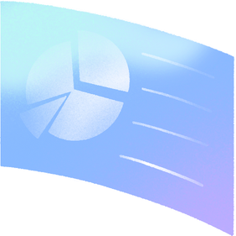


THANK YOU!

